Slide 1
Game design principles part I Advanced Game Design & Development
Danny Jugan

Slide 2
Game Design principles
Most of these principles are common sense
So why are we going over them?
1 – People (game designers) don’t always do what is common sense. You would think they do because it’s common sense, but you’d be surprised how often they don’t.
2 – It’s important to have specific reasons (and research) behind the decisions you’re making for your game.

Slide 3
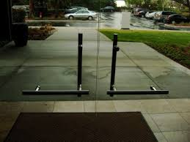
Affordance cues
The physical qualities of UI elements communicate how a player should interact with them.
On which side would
you push/pull?
Environment & Puzzles with appropriate affordance cues draws the player in and makes their interaction & engagement effortless

Slide 4
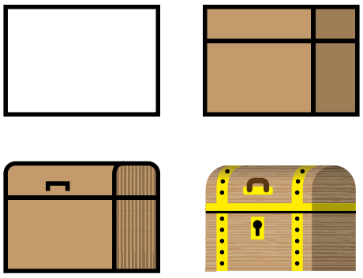
Affordance cues
Look at how it becomes more and more clear how you should interact with the item has more affordance is added.

Slide 5
Affordance cues
How to implement
Beveled Buttons show depth and promote interaction (players want to click them!)
Color coding and lightening/darkening sections of your HUD/GUI tells a player which parts they should interact with at a given time.
If you want to guide a player from one point to another in a game, put a pathway that’s consistent with the style/theme

Slide 6
The buster principle
Be kind to your players.
If it’s obvious a player has tried and failed a task several times – make it a bit easier on them.
The adjustment should be slight – unnoticeable if possible.
This is a smaller principle in the larger Dynamic Difficulty Adjustment (DDA) field.

Slide 7
Cognitive biases
Different people perceive, understand, and react to stimuli (playing games) differently.
These biases (filters) can skew “what happened” vs. “what I felt happened.”
A lot of these filters tend to operate in similar ways for all people

Slide 8
Cognitive biases
One type of Cognitive Bias is Confirmation Bias
People are drawn to information that aligns with what they already believe.
In games, people are more likely to notice events that confirm their preconceived notions about characters, events, or occurrences.

Slide 9

Cognitive biases
The Kuleshov Effect
Audiences reported
the man’s face on the
left showed a different
expression when placed
next to different images.

Slide 10
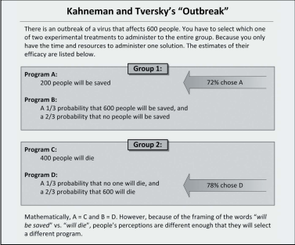
Cognitive biases

Slide 11
Cognitive biases
So what’s all this psychology stuff have to do with designing games?
Remember, as a game designer, it’s your job to create the experience for your players.
In order to do that, you have to understand their biases and how they’re going to react to your game.

Slide 12
Synergy
The whole is greater than the sum of its parts (1+1=3)
In games, this is accomplished by combing parts of gameplay that already exist into a larger, more cohesive (powerful) experience
Think of synergy like a list of ingredients (basic mechanics) and allowing the player to mix to come up with something better than the individual components.
This is how you can have two different games with the same mechanics and drastically different experiences.

Slide 13
Synergy
How to implement:
Allow players to combine character movements/actions
Fighting games – basic melee attacks can combine into more powerful moves
Platform games – coming running & jumping or allow those mechanics to interact with the environment in different ways.
Crafting
Allow players to take basic items from the world and combine them
Is Minecraft an example of synergy?

